Slide 1
What Cognitive Psychology and Neuroscience Tell Us About Learning
Jim O’Connor PhD
Director of the Center for Innovative Learning and Teaching
Touro University Western Division,
February, 2020

Slide 2
Objectives
Understand what cognitive psychology and neuroscience are
Understand that fundamentals of neuroscience related to effective learning
Understand which parts of the brain are related to learning and memory
Understand the basics of Human Information Processing
Understand the relationship of learning and memory

Slide 3
Objectives
Understand what cognitive psychology tells us about effective learning
Understand teaching practices from cognitive psychology that promote learning
Understand the relationship of emotions to learning
Understand some of the elements of the “musical brain”

Slide 4
What is cognitive psychology?
A branch of psychology concerned with mental processes (perception, thinking, learning, and memory) especially with respect to the internal events occurring between sensory stimulation and the overt expression of behavior.

Slide 5
What is Neuroscience?
A branch of the life sciences that deals with the anatomy, physiology, biochemistry, or molecular biology of nerves and nervous tissue and especially with their relation to behavior and learning.

Slide 6
What’s the difference?
Neuroscience focuses on the brain’s structure and the regions that are activated when people engage in various tasks. Cognitive Psychology, on the other hand, focuses on the mind and behavior.
Neuroscience is appealing partly because the data appears to be incontrovertible: just look at how different parts of the brain “light up!” But there’s a lot that brain scans can’t tell us—like whether a student is actually learning anything, or what to do if she isn’t. Changes in the brain may or may not have an impact on behavior.
Cognitive psychology, in contrast, has yielded a number of insights into what makes teaching and learning effective. When neuroscience does provide support for a particular pedagogical approach, it’s often just confirming something we already know from cognitive psychology.

Slide 7
What is the relationship of learning and memory?

Slide 8
Learning and memory
The relationship between learning and memory is incredibly close and intertwined. As stated by the American Psychological Association, learning means securing various skills and information, while memory relates to how the mind stores and recalls information. It is almost impossible for an individual to truly learn something without also having the memory to retain what they have learned. In many ways, learning and memory maintain a very interdependent relationship, one that is much more nuanced and complex than it may appear to be on the surface.

Slide 9
Learning and memory
Learning and memory share quite interesting parallels. First and foremost, both functions exist in and rely upon the brain. Without the brain, both learning and memory would be impossible. While learning can concern events that can take place in the past, present, and future, memory pertains to occurrences that have already passed. In other words, an individual can learn something new at virtually any time. Information, however, can only be mentally processed and stored in memory after learning.

Slide 10
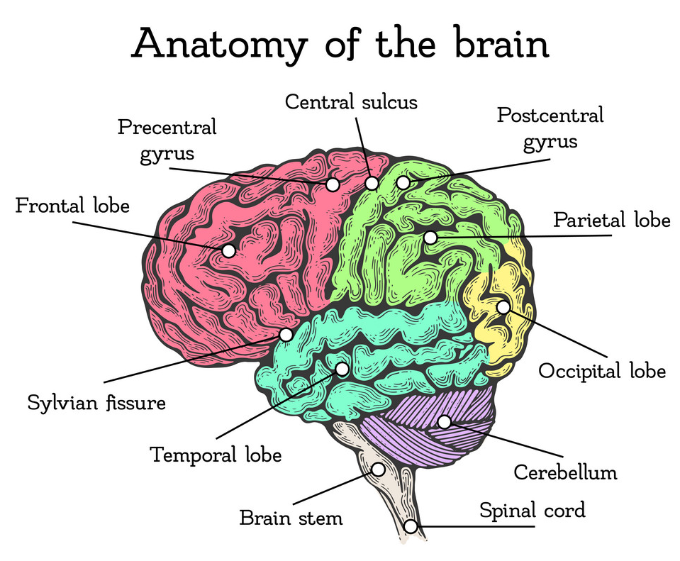
.

Slide 11
Dr. Jill Bolte Taylor: TED Talk
https://www.youtube.com/watch?v=UyyjU8fzEYU
1:30-6:30

Slide 12
Neuroscience fundamentals
For optimal learning to occur, the brain needs conditions under which it is able to change in response to stimuli (neuroplasticity) and able to produce new neurons (neurogenesis).
The most effective learning involves recruiting multiple regions of the brain for the learning task. These regions are associated with such functions as memory, the various senses, volitional control, and higher levels of cognitive functioning.

Slide 13
Neuroscience fundamentals
Moderate stress: Stress and performance are related in an “inverted U curve” Stimulation to learn requires a moderate amount of stress (measured in the level of cortisol). A low degree of stress is associated with low performance, as is high stress, which can set the system into fight-or-flight mode so there is less brain activity in the cortical areas where higher-level learning happens. Moderate levels of cortisol tend to correlate with the highest performance on tasks of any type. We can therefore conclude that moderate stress is beneficial for learning, while mild and extreme stress are both detrimental to learning.

Slide 14
Moderate stress can be introduced in many ways: by changing up the format of discussion, or introducing any learning activity that requires individual participation, or movement.
However, people do not all react the same way to an event. The production of cortisol in response to an event varies significantly between individuals; what constitutes “moderate stress” for one person might constitute mild or extreme stress for another. So, for example, cold-calling on individual students in a large-group setting might introduce just the right amount of stress to increase some students’ performance, but it might produce excessive stress and anxiety for other students, so their performance is below the level you know they are capable of.

Slide 15
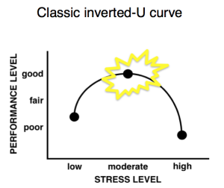
Moderate sStim

Slide 16
Neuroscience fundamentals
Adequate sleep, good nutrition, and regular exercise: These common-sense healthy habits promote optimal learning performance in two ways. First, they promote neuroplasticity and neurogenesis. Second, they keep cortisol and dopamine (stress and happiness hormones, respectively) at appropriate levels. All-night cramming sessions, skipped meals, and skipped exercise can actually reduce the brain’s capacity for high academic performance. (This is true for instructors as well as students.)

Slide 17
Neuroscience fundamentals
Active learning: Cognitive functions associated with the lower levels of Bloom’s taxonomy, such as understanding and remembering, are associated with the hippocampus (the area of the brain responsible for memory and spatial awareness). The higher-level cognitive functions of Bloom’s taxonomy, such as creating, evaluating, analyzing, and applying, involve the cortical areas responsible for decision-making, association, and motivation.
More complex thought processes are more beneficial for learning because they involve a greater number of neural connections and more neurological cross-talk. Active learning takes advantage of this cross-talk, stimulating a variety of areas of the brain and promoting memory.

Slide 18
Motivation is critical for learning
The anticipation of a future reward boosts dopamine signaling in the brain This increase in dopamine.
1.Boosts working memory, enhancing performance over the short term
2.Reinforces learning, increasing the chances of exhibiting the previously rewarded behavior in the future.
When an extrinsic reward is delivered over and over, it loses its value & is not as motivating anymore.

Slide 19
Human Information Processing

Slide 20
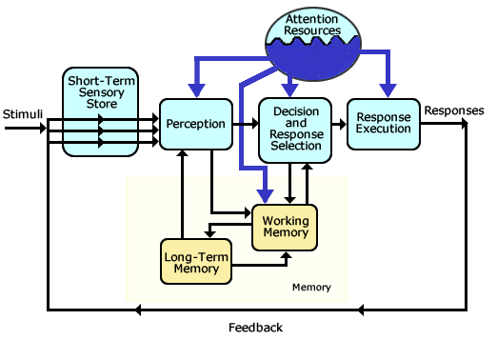
Human Information Processing
Wickens' Model of Human Information Processing*
*

Slide 21
Human Information Processing
Figure 1. Atkinson & Shiffrin Memory Model. Created by Dkahng and available on Wikimedia Commons under a CC-BY, Share Alike license.

Slide 22
Memory

Slide 23
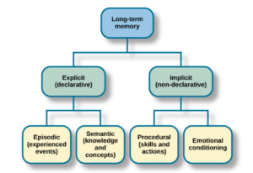
.
Figure 4. Available in the original OpenStax chapter.

Slide 24
Demonstrating Long Term Memory (LTM)
Write down one statement/fact that you remember from primary school (i.e. something you learned about geography, history, maths…) Why do you remember this?

Slide 25
The Memory Stores
Each store is a unitary structure and has its own characteristics in terms of encoding, capacity and duration.
Encoding is the way information is changed so that it can be stored in the memory. There are three main ways in which information can be encoded (changed):
1. visual (picture),
2. acoustic (sound),
3. semantic (meaning).
Capacity concerns how much information can be stored.
Duration refers to the period of time information can last in the memory stores.

Slide 26
Sensory Memory
• Duration: ¼ to ½ second
• Capacity: all sensory experience (v. larger capacity)
• Encoding: sense specific (e.g. different stores for each sense)
Short Term Memory
• Duration: 0-18 seconds
• Capacity: 7 +/- 2 items
• Encoding: mainly auditory
Long Term Memory
• Duration: Unlimited
• Capacity: Unlimited
• Encoding: Mainly Semantic (but can be visual and auditory)

Slide 27
Implicit memories
Implicit, or non-declarative, memories are behaviors that we have learned, but cannot verbalize. These memories typically operate without conscious awareness, encompassing skills, habits and behaviors.
These behaviors run on auto-pilot – for example, tying your shoelaces. It’s easy to do once learned, but it is very difficult to tell someone how you perform this task.
Multiple areas of the brain form implicit memories as they involve a variety of responses to be co-ordinated. A key region of the brain called the basal ganglia is involved in the formation of these “motor” programs. Additionally, the cerebellum at the back of the skull plays a vital role in the timing and execution of learned, skilled motor movement.

Slide 28
Explicit memories
Explicit, or declarative, memories can be verbally expressed. These include memories of facts and events, and spatial memories of locations. These memories can be consciously recalled and can be autobiographical – for instance, what you did for your last birthday – or conceptual, such as learning information for an exam.
These memories are easy to acquire. However, they are also easy to forget as they are susceptible to disruption during the process of forming and storing the information.

Slide 29
Short-term memory, or working memory, is stored for seconds to minutes, and has a very limited information capacity. Due to the limited capacity, working memory must “dump” information regularly. Unless this information is transferred to the long-term store it will be forgotten.
Our long-term memories are the recollections of our lives. For example, that phone number might be linked to our family home and be remembered for years into the future.
Many areas of the brain play a role in the formation and storage of declarative memory, but the two main regions involved are the hippocampus, the emotion center, and the prefrontal cortex at the very front of the brain.

Slide 30
Making long-term memories
There are multiple stages to forming an enduring memory, and information can be lost (or forgotten) along the way. The multistore model of memory proposes that long-term memories are made in three stages. Incoming information is transferred through sensory memory to short-term memory and then to long-term memory, rather than happening in one go.
The different types of memory each have their own particular mode of operation, but they all co-operate in the process of memorization and can be seen as three necessary steps in forming a lasting memory.
The information encoded in each of these steps has its own duration. First, we must be paying attention to the information we are going to encode – this is sensory memory. Our attention switches all the time, so the incoming information is often fleeting – like a snapshot – but it contains details of sounds, sensations and images.

Slide 31
The prefrontal cortex and working memory
The prefrontal cortex is important in the formation of short-term or working memory. Although these short-term memories are lost due to interference with new incoming information, they are essential for planning behaviors and deciding what actions to perform based on the current situation.

Slide 32
The hippocampus and long-term memory
A short-term memory can be consolidated into an enduring long-term memory. This involves a system of brain structures within the medial temporal lobe that are essential for forming declarative memories. The hippocampus is a key region in the medial temporal lobe, and processing information through the hippocampus is necessary for the short-term memory to be encoded into a long-term memory.
The long-term memory does not remain stored permanently in the hippocampus. These long-term memories are important and having them stored in only one brain location is risky – damage to that area would result in the loss of all of our memories.
Instead, it is proposed that long-term memories become integrated into the cerebral cortex (responsible for the higher order functions that make us human). This process is referred to as cortical integration; it protects the information stored in the brain.

Slide 33
Practices from Cognitive Psychology that Improve Learning
These four strategies led to consistent and reliable increases in students’ grades, confidence, and engagement (Agarwal et al., 2014). Consistently, researchers see a dramatic increase in both short-term and long-term learning (Adesope et al., 2017).
These strategies to have strong potential to boost learning for diverse students, grade levels, and subject. These strategies improve not just the learning of basic factual knowledge, but also skill learning and critical thinking (McDaniel, et al., 2013).

Slide 34
Think-Pair-Share( 4 minutes)
What teaching/learning strategies do you believe boost learning?
Think: one minute
Write: One Minute
Share: Two Minutes

Slide 35
Retrieval practice boosts learning
Retrieval practice boosts learning by pulling information out of students’ heads (eg. by responding to a brief writing prompt), rather than cramming information into their heads (by lecturing at students, for example). In the classroom, retrieval practice can take many forms, including a quick no-stakes quiz. When students are asked to retrieve new information, they don’t just show what they know, they solidify and expand it. Lessons for learning: How cognitive psychology informs classroom practice, Pooja K. Agarwal and Henry L. Roediger III, November 26, 2018. Phi Delta Kappan

Slide 36
Feedback boosts learning
Feedback boosts learning by revealing to students what they know and what they don’t know. At the same time, this increases students’ metacognition — their understanding about their own learning progress.

Slide 37
Spaced practice boosts learning
Spaced practice boosts learning by spreading lessons and retrieval opportunities out over time so that new knowledge and skills are not crammed in all at once. By returning to content every so often, students’ knowledge has time to be consolidated and then refreshed.

Slide 38
Interleaving boosts learning
Interleaving — or practicing a mix of skills (such as doing addition, subtraction, multiplication, and division problems all in one sitting) — boosts learning by encouraging connections between and discrimination among closely related topics. Interleaving sometimes slows students’ initial learning of a concept, but it leads to greater retention and learning over time.

Slide 39
key principles of learning associated with cognitive psychology
Instruction should be well-organized. Well-organized materials easier to learn and to remember.
Instruction should be clearly structured. Subject matters are said to have inherent structures – logical relationships between key ideas and concepts – which link the parts together.

Slide 40
key principles of learning associated with cognitive psychology
The perceptual features of the task are important. Learners attend selectively to different aspects of the environment. Thus, the way a problem is displayed is important if learners are to understand it.
Prior knowledge is important. Things must fit with what is already known if it is to be learned.

Slide 41
key principles of learning associated with cognitive psychology
Differences between individuals are important as they will affect learning. Differences in ‘cognitive style’ or methods of approach influence learning.
Cognitive feedback gives information to learners about their success or failure concerning the task at hand. Reinforcement can come through giving information – a ‘knowledge of results’ – rather than simply a reward.

Slide 42
Emotions, memory, and learning
Emotion has a substantial influence on the cognitive processes in humans, including perception, attention, learning, memory, reasoning, and problem solving.
Emotion has a particularly strong influence on attention, especially modulating the selectivity of attention as well as motivating action and behavior.
This attentional and executive control is intimately linked to learning processes, as intrinsically limited attentional capacities are better focused on relevant information.

Slide 43
Emotions, memory, and learning
Emotion also facilitates encoding and helps retrieval of information efficiently.
However, the effects of emotion on learning and memory are not always univalent, as studies have reported that emotion either enhances or impairs learning and long-term memory (LTM) retention, depending on a range of factors.

Slide 44
Emotions, memory, and learning
Recent neuroimaging findings have indicated that the amygdala and prefrontal cortex cooperate with the medial temporal lobe in an integrated manner that affords (i) the amygdala modulating memory consolidation; (ii) the prefrontal cortex mediating memory encoding and formation; and (iii) the hippocampus for successful learning and LTM retention.
In addition to elucidating the memory-enhancing effects of emotion, neuroimaging findings extend our understanding of emotional influences on learning and memory processes;
this knowledge may be useful for the design of effective educational curricula to provide a conducive learning environment for both traditional “live” learning in classrooms and “virtual” learning through online-based educational technologies.

Slide 45
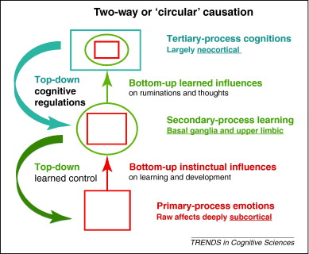
Emotions, memory, and learning
Forum Special Issue: Cognition in Neuropsychiatric Disorders| Volume 16, ISSUE 1, P6-8, January 01, 2012
What is neuropsychoanalysis? Clinically relevant studies of the minded brain
Jaak Panksepp andMark Solms
December 06, 2011DOI:https://doi.org/10.1016/j.tics.2011.11.005

Slide 46
The musical brain
It can bring us to tears or to our feet, drive us into battle or lull us to sleep. Music is indeed remarkable in its power over all humankind. Perhaps for that very reason, no human culture on earth has ever lived without it: people making music predates agriculture and perhaps even language.

Slide 47
The musical brain
Researchers have discovered that music like language stimulates many areas in the brain, including regions normally involved in other kinds of thinking.
Mark Jude Tramo of the Harvard Medical School argues in a recent issue of Science that the brain doesn't have a specific "music center"
As an example, he points to the left planum temporale. This tiny brain region is critical to the golden musical gift of perfect pitch the rare ability to recognize by ear a perfect middle C
The left planum temporale also plays an important role in language processing.
There is "no grossly identifiable brain structure that works solely during music cognition. However, distinctive patterns of neural activity within the auditory cortex and other areas of the brain may imbue specificity to the processing of music." (Tramo)

Slide 48
The musical brain
Music stimulates our drive to find patterns in the environment.
Our brain is constantly trying to make order out of disorder, and music is a fantastic pattern game for our higher cognitive centers
From our culture, we learn (even if unconsciously) about musical structures, tones and other ways of understanding music as it unfolds over time
Our brains are exercised by extracting different patterns and groupings from music's performance

Slide 49
The musical brain
Music goes much deeper than that below the outer layers of the auditory and visual cortex to the limbic system, which controls our emotions.
The emotions generated there produce a number of well-known physiological responses.
Sadness, for instance, automatically causes pulse to slow, blood pressure to rise, a drop in the skin's conductivity and a rise in temperature.
Fear increases heart rate; happiness makes you breathe faster.
Music directly elicits a range of emotions. Music with a quick tempo in a major key brings about all the physical changes associated with happiness in listeners. In contrast, a slow tempo and minor key led to sadness.

