Slide 1
ZOOM
Using the Polling
&
Whiteboard Features
Julie Horwath
Touro University California
Electronic Resources Librarian
julie.horwath@tu.edu

Slide 2
POLLING
How to create, launch, and share polls.

Slide 3
IMPORTANT!
You can create up to 25 polls for a single meeting
Each poll can have a single question or a series of questions.
You can make the poll responses anonymous or not.
You can allow a single answer or multiple answers to each question

Slide 4
Turning the Polling Feature On
Go to Zoom web portal (zoom.us) and login
Go to SETTINGS
Scroll down to POLLING and toggle it on.
Zoom polling help:
https://support.zoom.us/hc/en-us/articles/213756303-Polling-for-meetings

Slide 5
Adding Polls to Your Meetings
IMPORTANT!
YOU MUST FIRST SCHEDULE THE MEETING IN WHICH YOU WANT TO USE THE POLLING FEATURE.
Go to MEETINGS page and select the meeting in which you want to add the poll.
Scroll to the bottom of the page where you see the following box and click Add.
:
OR
In the meeting in which you want to add the poll, click the Polling icon.
Zoom polling help:
https://support.zoom.us/hc/en-us/articles/213756303-Polling-for-meetings

Slide 6
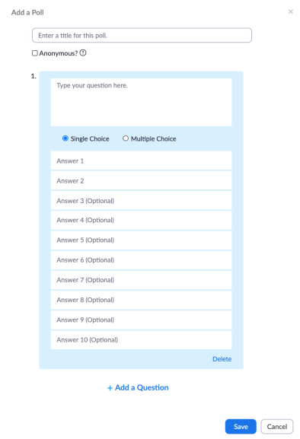
Creating a Poll
Name your poll.
Do you want it to be anonymous? If so, check the box.
Type your question in the big box
How many choices for an answer?
Single choice: respondent can only select one response.
Multiple choice: respondent can select as many answers as they wish.
Enter the answers you want to provide – up to 10
Add more questions if you choose.
Click SAVE to save the poll.
Repeat these steps to add another poll.
Zoom polling help:
https://support.zoom.us/hc/en-us/articles/213756303-Polling-for-meetings

Slide 7
Reviewing Your Polls
Make sure your polls are ready to go!
Now, when you go to the page of a scheduled meeting, you should see your polls at the very bottom of the page.
From this page you can also:
Edit the polls you created and their questions
Delete a poll
Add another poll
Zoom polling help:
https://support.zoom.us/hc/en-us/articles/213756303-Polling-for-meetings

Slide 8
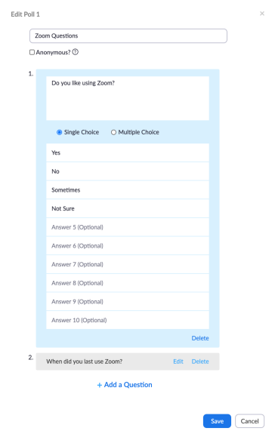
Editing a Poll
If you click EDIT, the box you used to create the poll will pop up.
Simply make the edits the same way you created the poll:
Re-type text you want to change
Delete questions
Add questions
Make anonymous or not
Change number of answer choices→ multiple or single
Remember to click SAVE when you are done.
Zoom polling help:
https://support.zoom.us/hc/en-us/articles/213756303-Polling-for-meetings

Slide 9
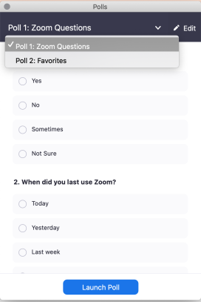
Launching a Poll
To launch a poll, click the POLLING icon in the Zoom control bar.
A box will pop up, where you select the poll you want to launch (if you have more than one).
When you have selected the correct poll, click LAUNCH POLL.
Zoom polling help:
https://support.zoom.us/hc/en-us/articles/213756303-Polling-for-meetings

Slide 10
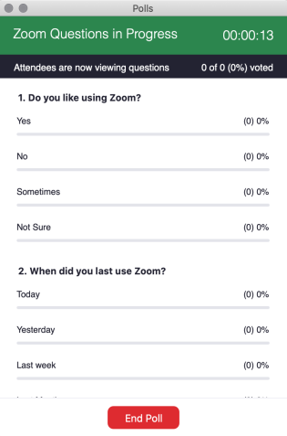
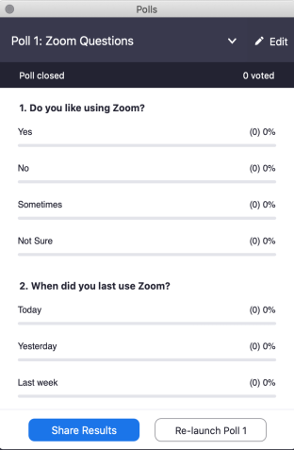
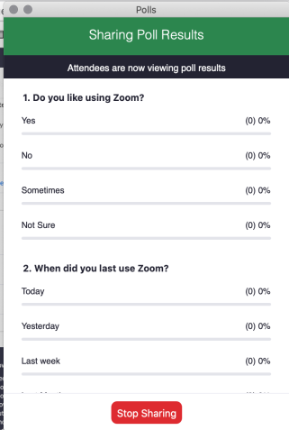
Your Views of Launched Polls

Slide 11
The Whiteboard
How to use, annotate and save the whiteboard.

Slide 12
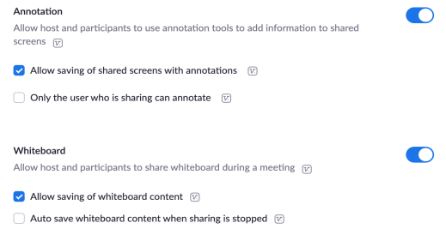
Turning the Whiteboard & Annotation Features On
Go to Zoom web portal (zoom.us) and login
Go to SETTINGS
Scroll down to Annotation & Whiteboard and toggle them both on.
Zoom whiteboard help:
https://support.zoom.us/hc/en-us/articles/205677665-Sharing-a-whiteboard

Slide 13
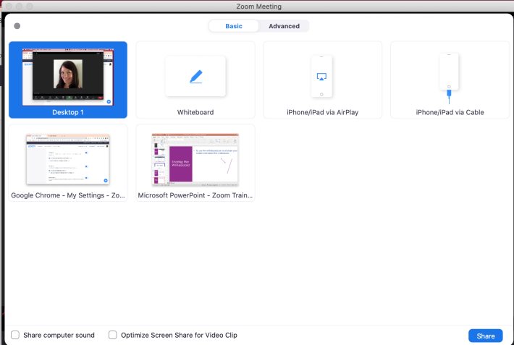
Sharing the Whiteboard
1
To use the whiteboard, you must share your screen and select the Whiteboard.
Zoom whiteboard help:
https://support.zoom.us/hc/en-us/articles/205677665-Sharing-a-whiteboard
2

Slide 14
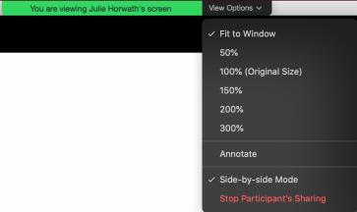
Annotation Tool Bar
The annotation toolbar will pop up when a participant begins sharing the whiteboard
The ANNOTATE button will appear in the meeting controls when a participant begins sharing their screen
Participants can get the annotation toolbar by going to the VIEW OPTIONS dropdown menu at the top of their screen and selecting ANNOTATE.
Zoom annotation help: https://support.zoom.us/hc/en-us/articles/115005706806-Using-annotation-tools-on-a-shared-screen-or-whiteboard

Slide 15
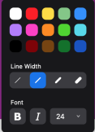
Annotation
Zoom annotation help: https://support.zoom.us/hc/en-us/articles/115005706806-Using-annotation-tools-on-a-shared-screen-or-whiteboard
Only the person sharing will see the SELECT tool and can move anyone’s annotations around the screen.
The SPOTLIGHT tool is only available to the person who started the share. The arrow is available to all participants.
The person who started the share can use the ERASER to remove anyone’s annotations; everyone else can only erase their own annotations.
The screen sharer can CLEAR the entire whiteboard or just their own or other’s drawings.
If enabled, participants can save the shared screen/whiteboard to their devices, as a .png or PDF.

Slide 16
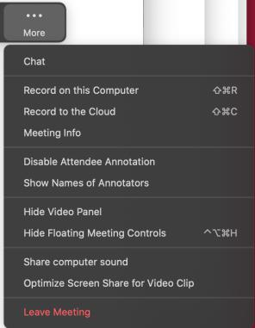
Annotation Settings
The person who started the share can turn participants’ annotation on and off by going to the MORE button in the tool bar.
By clicking the MORE button the person who started the share can hide or share the names of annotators
Zoom annotation help page: https://support.zoom.us/hc/en-us/articles/115005706806-Using-annotation-tools-on-a-shared-screen-or-whiteboard

Slide 17
QUESTIONS?
ZOOM HELP CENTER: https://support.zoom.us/hc/en-us
julie.horwath@tu.edu

